Slide 1
Detector Physics
Radiation Interacting with Matter
D. Lascar | Postdoctoral Fellow | TRIUMF

Slide 2
Outline
Radiation Interacting with Matter
Cross Section (σ)
Mean Free Path (λ)
Energy Loss
Electrons
Cherenkov Radiation
Bremsstrahlung
Phontons
Neutrons

Slide 3
Charged particles going through matter
Two things happen most of the time:
Inelastic collisions with the target’s electrons
Elastic scattering of the target’s nuclei
More interesting things happen less often
Cherenkov radiation emission
Nuclear reactions
Bremsstrahlung
The reason we’re in business
1 barn = 10⁻²⁴ cm²
Notes:
Smallest cross sections: Gamma-induced beta-decay (~10⁻³ b)
Largest reaction cross sections: Thermal neutron absorptions (~10³ b)
Inellastic electrons with atomic electrons: (10⁷ – 10⁸ b)

Slide 4
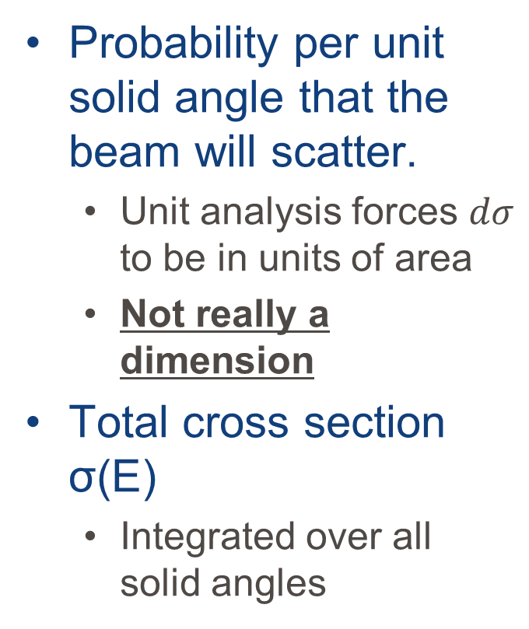
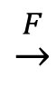
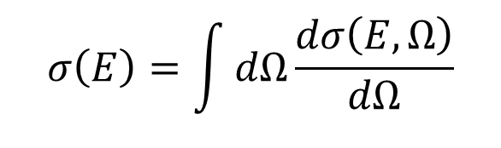
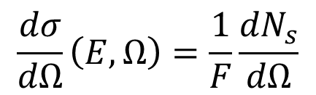
Idealized Cross Section (σ) – 1 scatterer
Probability per unit solid angle that the beam will scatter.
Unit analysis forces $dσ$ to be in units of area
Not really a dimension
Total cross section σ(E)
Integrated over all solid angles
$$\frac{dσ}{dΩ}\left(E,Ω\right)=\frac{1}{F}\frac{{dN}_{s}}{dΩ}$$
$$\underset{→}{F}$$
dΩ
Beam
Target
$$σ\left(E\right)=\int{dΩ\frac{dσ\left(E,Ω\right)}{dΩ}}$$
Notes:
Scattering = any reaction where any outgoing particle is emitted.
F = Flux = Number of incident particles/unit area/unit time
N_{s} = Average number of scattered particles per unit time

Slide 5
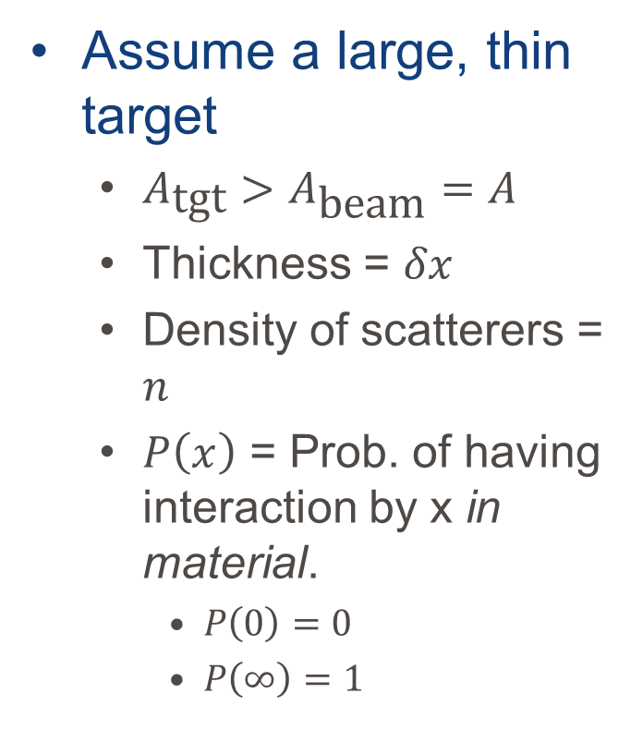
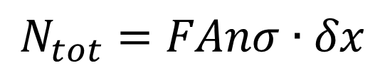
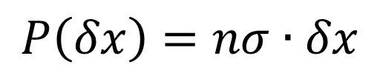
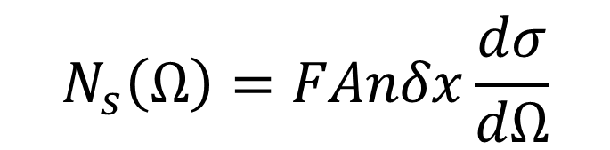
Thin sheet of material
Assume a large, thin target
$A_{\text{tgt}}>A_{\text{beam}}=A$
Thickness = $δx$
Density of scatterers = $n$
$P\left(x\right)$ = Prob. of having interaction by x in material.
$P\left(0\right)=0$
$P\left(∞\right)=1$
$$N_{s}\left(Ω\right)=FAnδx\frac{dσ}{dΩ}$$
$$N_{tot}=FAnσ∙δx$$
$$P\left(δx\right)=nσ∙δx$$
Notes:
Targets of single atoms aren’t practical

Slide 6
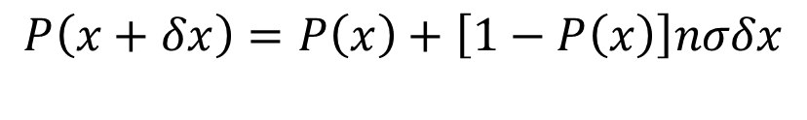
Interaction probabilities
$$\begin{aligned}P\left(x+δx\right)&=&&P\left(x\right)+\left[1−P\left(x\right)\right]nσδx \\ \end{aligned}$$
The probability of not interacting

Slide 7
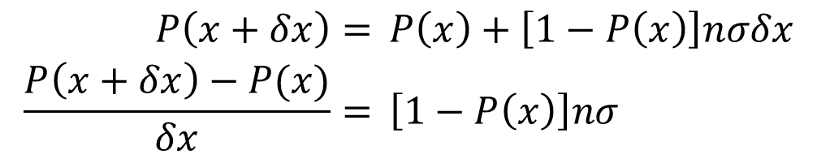
Interaction probabilities
$$\begin{aligned}P\left(x+δx\right)&=&&P\left(x\right)+\left[1−P\left(x\right)\right]nσδx \\ \frac{P\left(x+δx\right)−P(x)}{δx}&=&&\left[1−P\left(x\right)\right]nσ\end{aligned}$$
Definition of a derivative

Slide 8
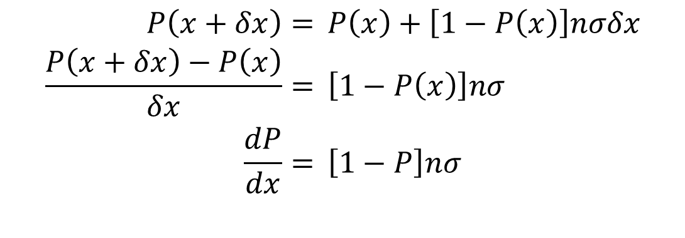
Interaction probabilities
$$\begin{aligned}P\left(x+δx\right)&=&&P\left(x\right)+\left[1−P\left(x\right)\right]nσδx \\ \frac{P\left(x+δx\right)−P\left(x\right)}{δx}&=&&\left[1−P\left(x\right)\right]nσ \\ \frac{dP}{dx}&=&&\left[1−P\right]nσ\end{aligned}$$

Slide 9
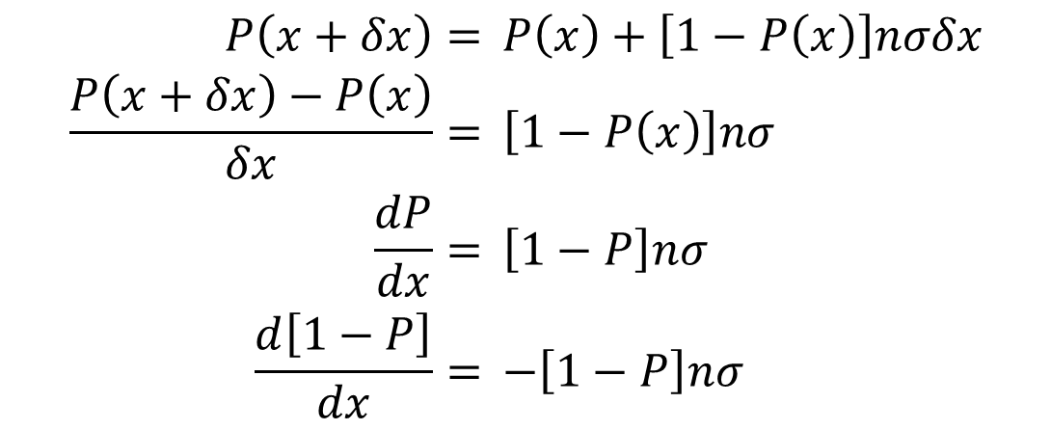
Interaction probabilities
$$\begin{aligned}P\left(x+δx\right)&=&&P\left(x\right)+\left[1−P\left(x\right)\right]nσδx \\ \frac{P\left(x+δx\right)−P\left(x\right)}{δx}&=&&\left[1−P\left(x\right)\right]nσ \\ \frac{dP}{dx}&=&&\left[1−P\right]nσ \\ \frac{d\left[1−P\right]}{dx}&=&&−\left[1−P\right]nσ\end{aligned}$$
The change in the probability of noninteraction is necessarily the negative of the change in the probability of interaction.

Slide 10
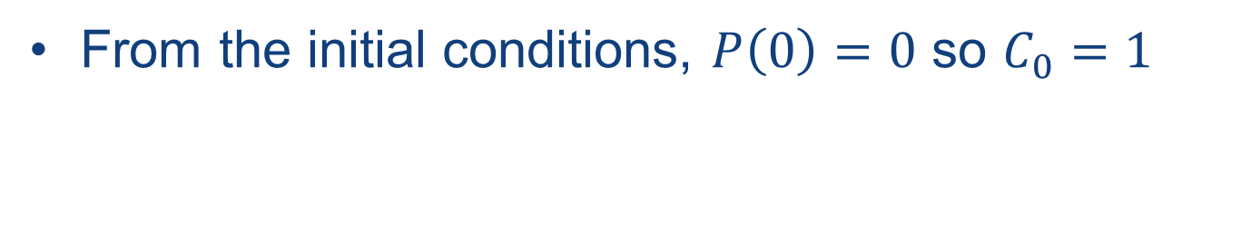
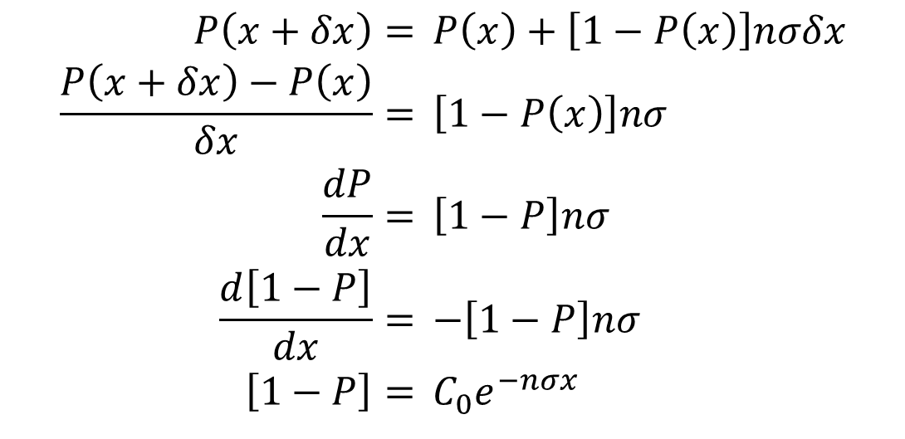
Interaction probabilities
$$\begin{aligned}P\left(x+δx\right)&=&&P\left(x\right)+\left[1−P\left(x\right)\right]nσδx \\ \frac{P\left(x+δx\right)−P\left(x\right)}{δx}&=&&\left[1−P\left(x\right)\right]nσ \\ \frac{dP}{dx}&=&&\left[1−P\right]nσ \\ \frac{d\left[1−P\right]}{dx}&=&&−\left[1−P\right]nσ \\ \left[1−P\right]&=&&{C_{0}^{}e}^{−nσx}\end{aligned}$$
From the initial conditions, $P\left(0\right)=0$ so $C_{0}=1$

Slide 11
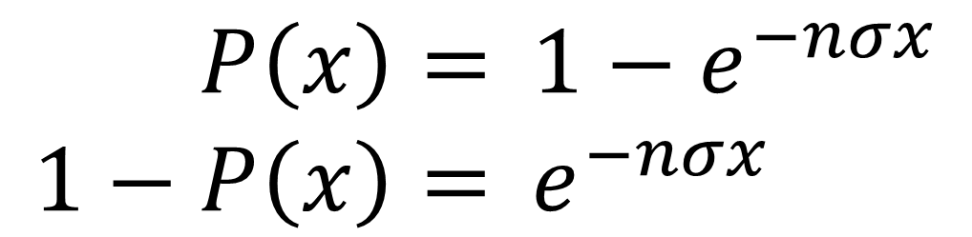
Interaction probabilities
Prob. of interaction between 0 an x
$$\begin{aligned}P\left(x\right)&=&&1−e^{−nσx} \\ 1−P\left(x\right)&=&&e^{−nσx}\end{aligned}$$
Prob. of not interacting between 0 and x

Slide 12
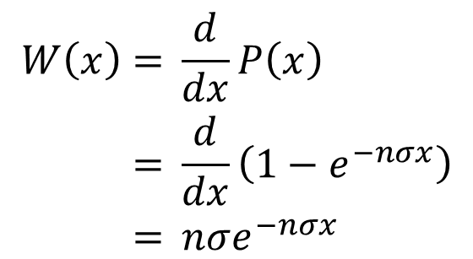
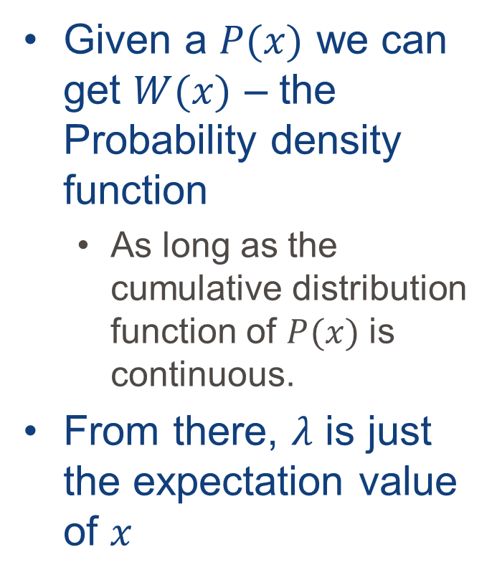
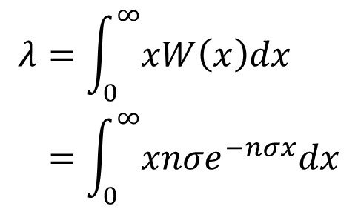
Mean free path - λ
Given a $P(x)$ we can get $W(x)$ – the Probability density function
As long as the cumulative distribution function of $P(x)$ is continuous.
From there, $λ$ is just the expectation value of $x$
$$\begin{aligned}W\left(x\right)&=&&\frac{d}{dx}P\left(x\right) \\ &=&&\frac{d}{dx}\left(1−e^{−nσx}\right) \\ &=&&nσe^{−nσx}\end{aligned}$$
$$\begin{aligned}λ&=&&\int_{0}^{∞}{xW\left(x\right)dx} \\ &=&&\int_{0}^{∞}{xnσe^{−nσx}dx}\end{aligned}$$

Slide 13
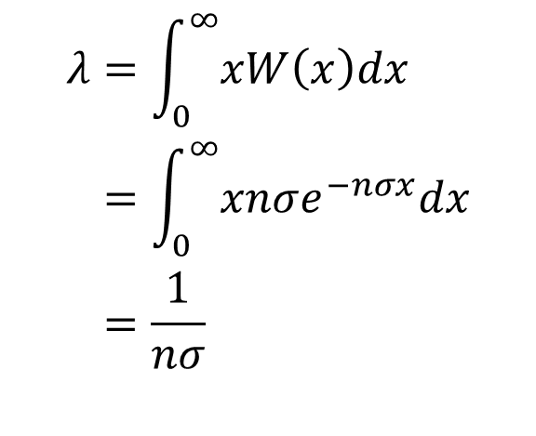
Mean free path - λ
Given a $P(x)$ we can get $W(x)$ – the Probability density function
As long as the cumulative distribution function of $P(x)$ is continuous.
From there, $λ$ is just the expectation value of $x$
$$\begin{aligned}W\left(x\right)&=&&\frac{d}{dx}P\left(x\right) \\ &=&&\frac{d}{dx}\left(1−e^{−nσx}\right) \\ &=&&nσe^{−nσx}\end{aligned}$$
$$\begin{aligned}λ&=&&\int_{0}^{∞}{xW\left(x\right)dx} \\ &=&&\int_{0}^{∞}{xnσe^{−nσx}dx} \\ &=&&\frac{1}{nσ}\end{aligned}$$

Slide 14
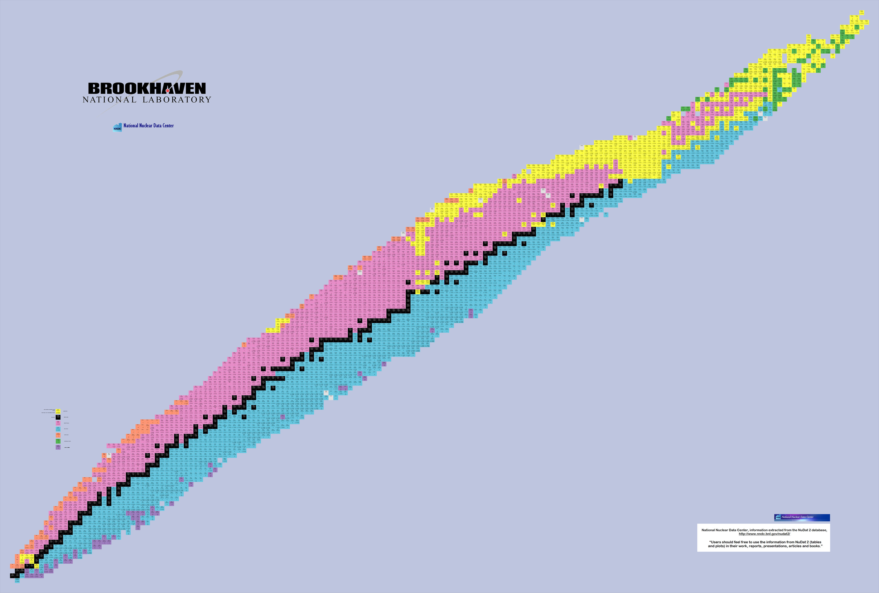
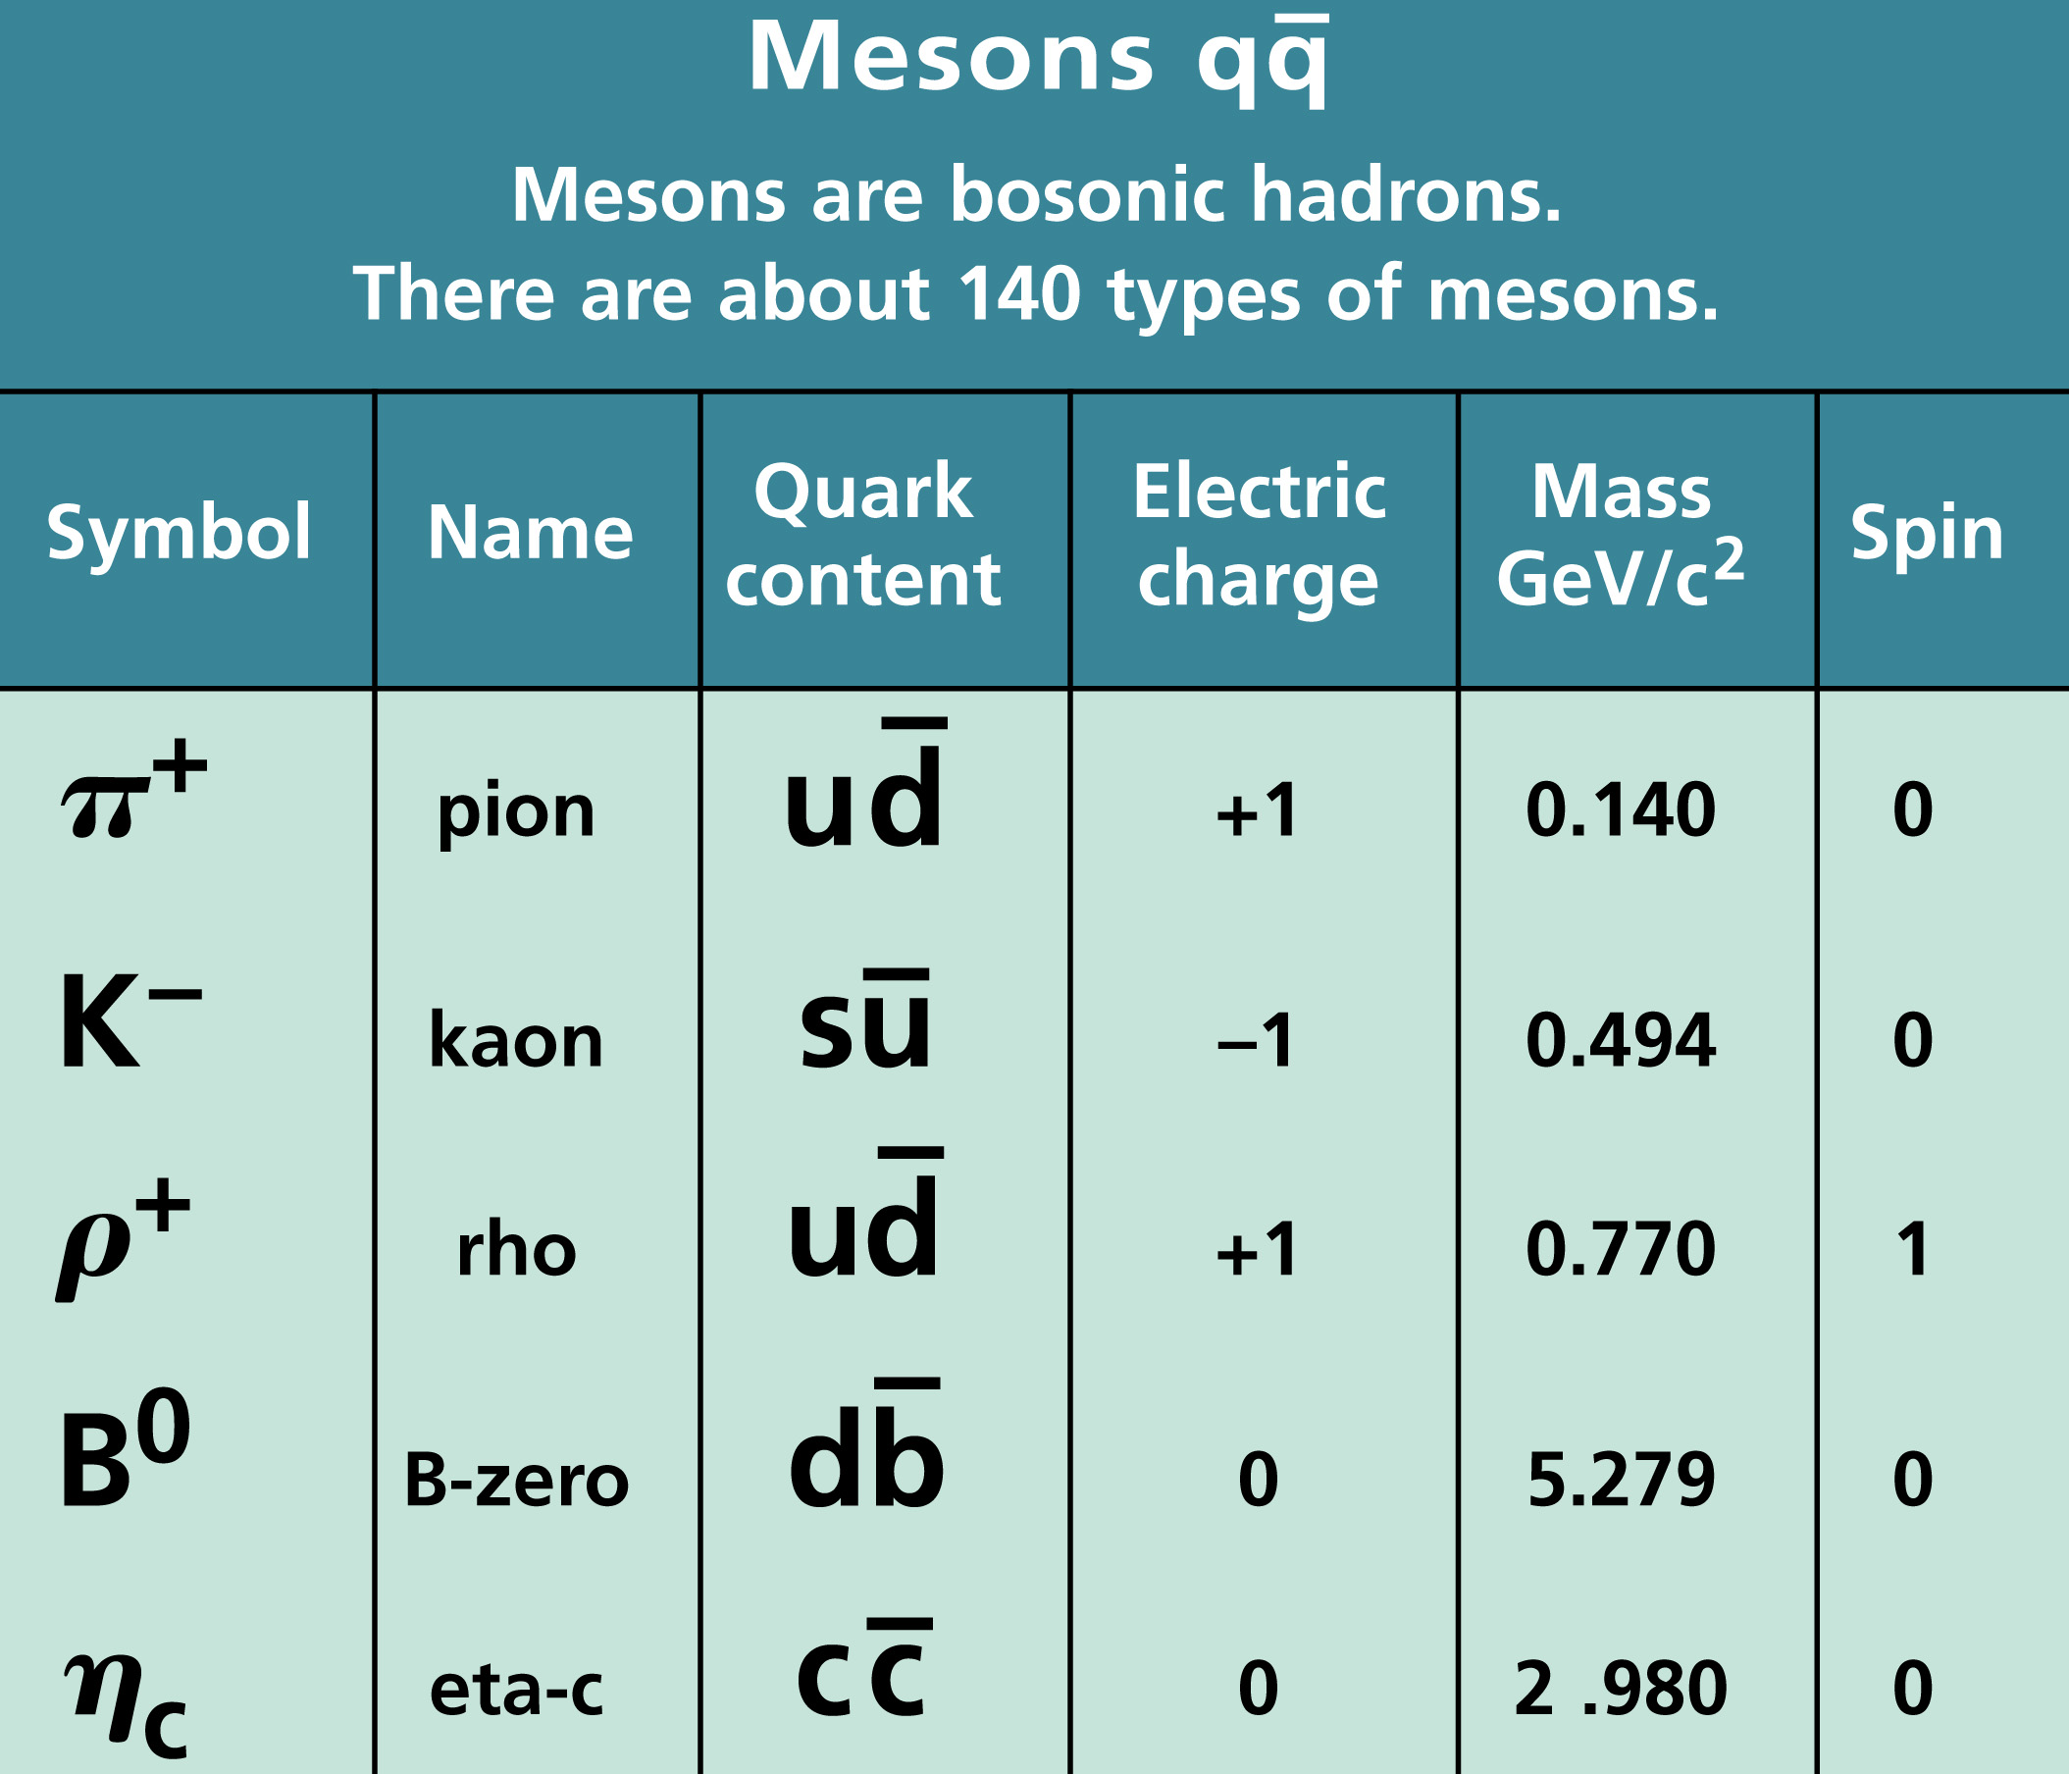
Charged particle energy loss
Dealing with 2 regimes
e⁻ & e⁺
Just about everything else

Slide 15
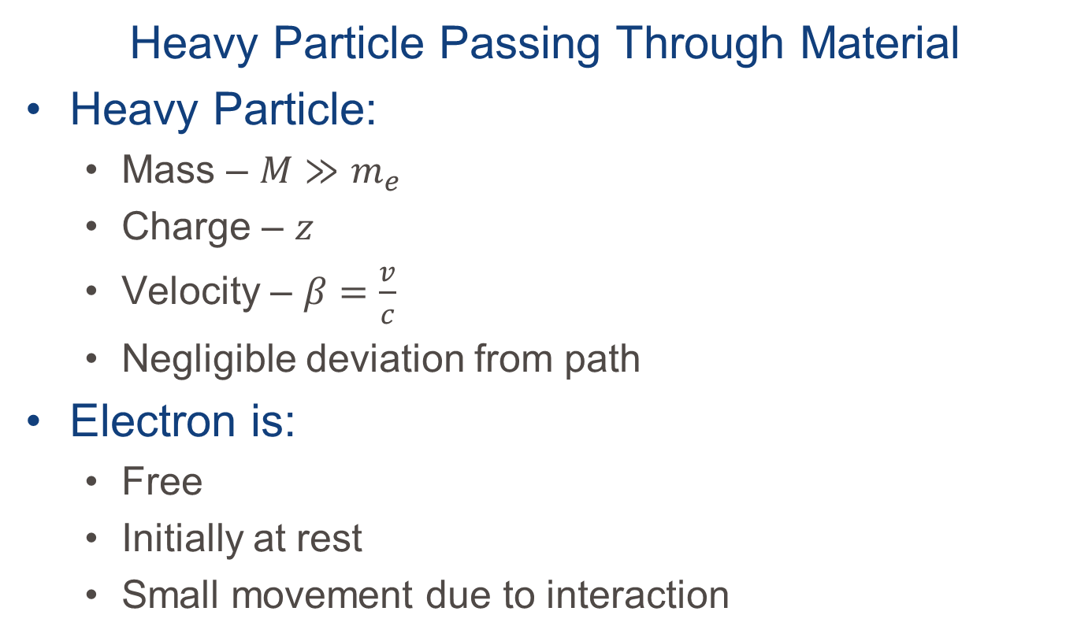
Let’s look at the classical picture
Heavy Particle Passing Through Material
Heavy Particle:
Mass – $M≫m_{e}$
Charge – $z$
Velocity – $β=\frac{v}{c}$
Negligible deviation from path
Electron is:
Free
Initially at rest
Small movement due to interaction

Slide 16
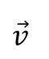
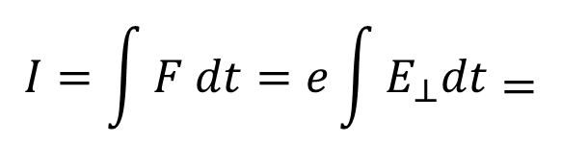
Let’s look at the classical picture
e
$$\vec{v}$$
`
b
x
`
M,z
$$\begin{aligned}I&=&&\int{F dt}=e\int{E_{⊥}dt}\end{aligned}=$$
Notes:
We start with the momentum imparted to the electron by the heavy particle

Slide 17
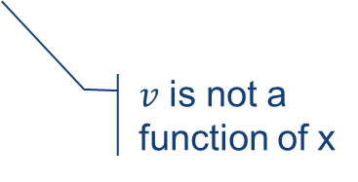
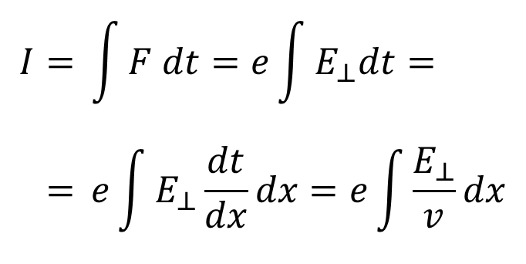
Let’s look at the classical picture
e
$$\vec{v}$$
`
b
x
`
M,z
All other components of E cancel out
$$\begin{aligned}I&=&&\int{F dt}=e\int{E_{⊥}dt}= \\ &=&&e\int{E_{⊥}\frac{dt}{dx}dx}=e\int{\frac{E_{⊥}}{v}dx}\end{aligned}$$
$v$ is not a function of x
Notes:
All other components of the electric filed cancel and what remains is the E-field component perpendicular particle’s trajectory.

Slide 18
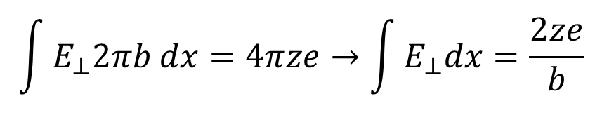
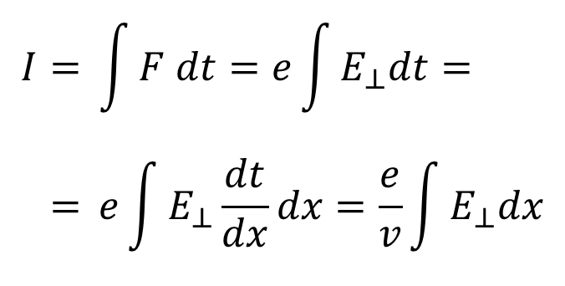
Let’s look at the classical picture
e
$$\vec{v}$$
`
b
x
`
M,z
$$\begin{aligned}I&=&&\int{F dt}=e\int{E_{⊥}dt}= \\ &=&&e\int{E_{⊥}\frac{dt}{dx}dx}=\frac{e}{v}\int{E_{⊥}dx}\end{aligned}$$
Apply Here
$$\int{E_{⊥}2πb dx}=4πze→\int{E_{⊥}dx}=\frac{2ze}{b}$$
Notes:
To calculate the integral we use Gauss' Law over an infinitely long cylinder centered on the particle trajectory and passing through the position of the electron

Slide 19
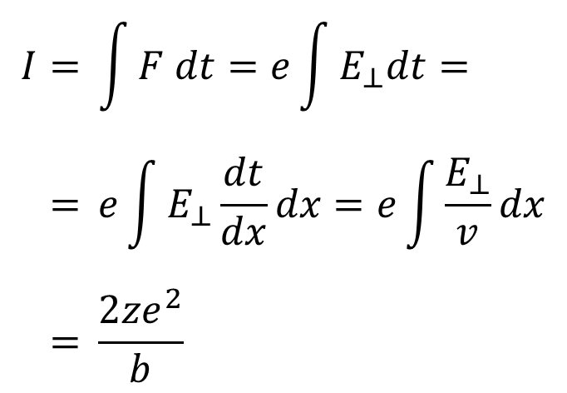
Let’s look at the classical picture
e
$$\vec{v}$$
`
b
x
`
M,z
$$\begin{aligned}I&=&&\int{F dt}=e\int{E_{⊥}dt}= \\ &=&&e\int{E_{⊥}\frac{dt}{dx}dx}=e\int{\frac{E_{⊥}}{v}dx} \\ &=&&\frac{2ze^{2}}{b}\end{aligned}$$
$$\int{E_{⊥}2πb dx}=4πze→\int{E_{⊥}dx}=\frac{2ze}{b}$$

Slide 20
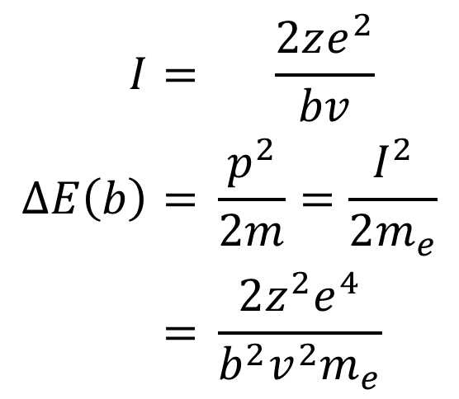
The energy gained by the e⁻ is:
$$\begin{aligned}I&=&\frac{2ze^{2}}{bv} \\ ΔE\left(b\right)&=&&\frac{p^{2}}{2m}=\frac{I^{2}}{2m_{e}} \\ &=&&\frac{2z^{2}e^{4}}{b^{2}v^{2}m_{e}}\end{aligned}$$

Slide 21
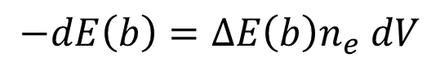
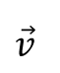
So the energy lost by the heavy ion is:
$$\begin{aligned}−dE\left(b\right)&=&&ΔE\left(b\right)n_{e} dV\end{aligned}$$
e
$$\vec{v}$$
`
b
x
`
M,z
db
Notes:
The energy lost to all the electrons in a volume of thickness dx and radius from b to b+db
n_{e} is the electron density

Slide 22
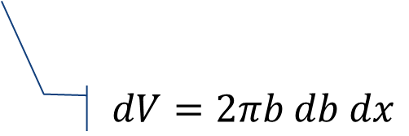
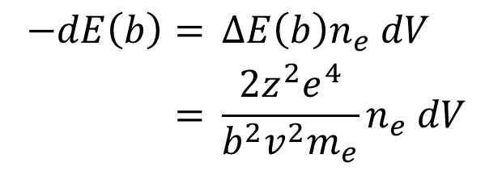
So the energy lost by the heavy ion is:
$$\begin{aligned}−dE\left(b\right)&=&&ΔE\left(b\right)n_{e} dV \\ &=&&\frac{2z^{2}e^{4}}{b^{2}v^{2}m_{e}}n_{e} dV \end{aligned}$$
e
$$dV=2πb db dx$$
$$\vec{v}$$
`
b
x
`
M,z
db

Slide 23
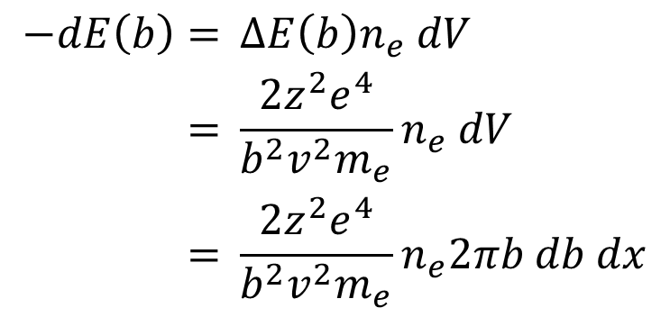
So the energy lost by the heavy ion is:
$$\begin{aligned}−dE\left(b\right)&=&&ΔE\left(b\right)n_{e} dV \\ &=&&\frac{2z^{2}e^{4}}{b^{2}v^{2}m_{e}}n_{e} dV \\ &=&&\frac{2z^{2}e^{4}}{b^{2}v^{2}m_{e}}n_{e}2πb db dx\end{aligned}$$

Slide 24
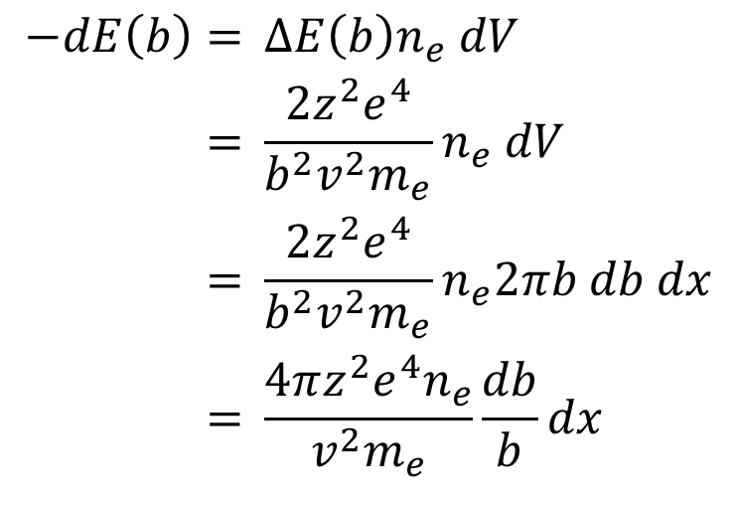
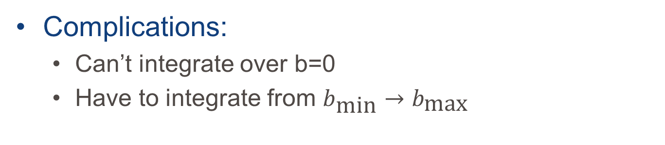
So the energy lost by the heavy ion is:
$$\begin{aligned}−dE\left(b\right)&=&&ΔE\left(b\right)n_{e} dV \\ &=&&\frac{2z^{2}e^{4}}{b^{2}v^{2}m_{e}}n_{e} dV \\ &=&&\frac{2z^{2}e^{4}}{b^{2}v^{2}m_{e}}n_{e}2πb db dx \\ &=&&\frac{4πz^{2}e^{4}n_{e}}{v^{2}m_{e}}\frac{db}{b}dx\end{aligned}$$
Complications:
Can’t integrate over b=0
Have to integrate from $b_{\text{min}}→b_{\text{max}}$

Slide 25
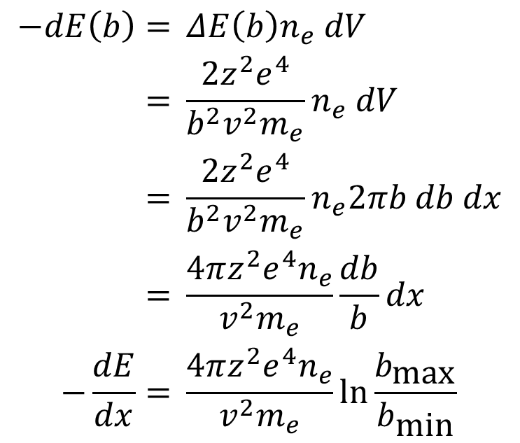
So the energy lost by the heavy ion is:
$$\begin{aligned}−dE\left(b\right)&=&&ΔE\left(b\right)n_{e} dV \\ &=&&\frac{2z^{2}e^{4}}{b^{2}v^{2}m_{e}}n_{e} dV \\ &=&&\frac{2z^{2}e^{4}}{b^{2}v^{2}m_{e}}n_{e}2πb db dx \\ &=&&\frac{4πz^{2}e^{4}n_{e}}{v^{2}m_{e}}\frac{db}{b}dx \\ −\frac{dE}{dx}&=&&\frac{4πz^{2}e^{4}n_{e}}{v^{2}m_{e}}\ln{\frac{b_{\text{max}}}{b_{\text{min}}}}\end{aligned}$$

Slide 26
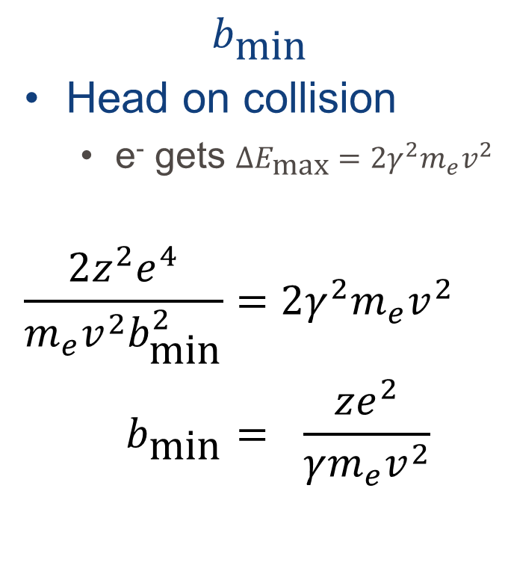

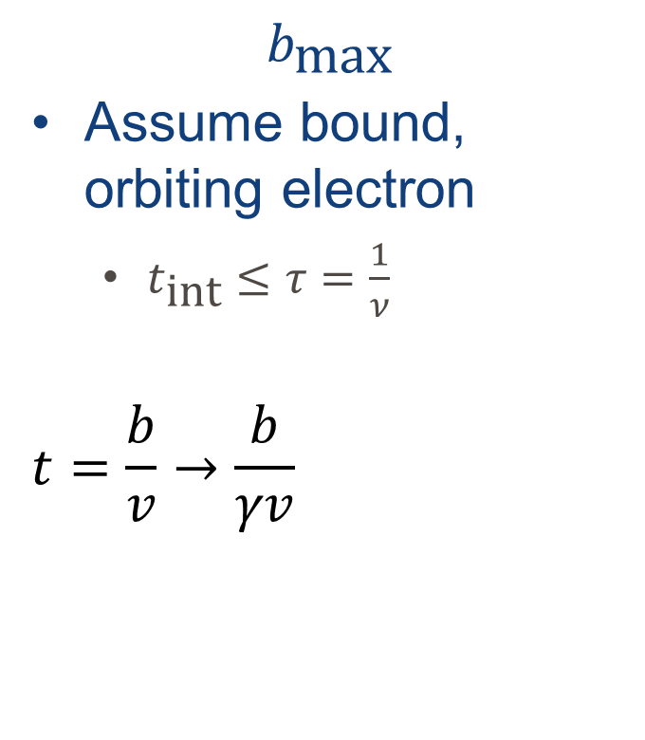
$b_{\text{max}}$ & $b_{\text{min}}$
$$b_{\text{min}}$$
Head on collision
e⁻ gets $∆E_{\text{max}}=2γ^{2}m_{e}v^{2}$
$$\begin{aligned}\frac{2z^{2}e^{4}}{m_{e}v^{2}b_{\text{min}}^{2}}&=&2γ^{2}m_{e}v^{2} \\ b_{\text{min}}&=&\frac{ze^{2}}{γm_{e}v^{2}}\end{aligned}$$
$$b_{\text{max}}$$
Assume bound, orbiting electron
$t_{\text{int}}≤τ=\frac{1}{ν}$
$$t=\frac{b}{v}→\frac{b}{γv}$$
Frequency, not velocity
Interaction time
Notes:
Classically ΔE=(1/2)m(2v)²
w/Relativity, ΔE = (1/2)m(2vγ)²=2γ²mv²
t_{int} must be small relative to the period of the bound electron because “otherwise the perturbation is adiabatic and no energy is transferred.”
This is what is known as “adiabatic invariance”

Slide 27
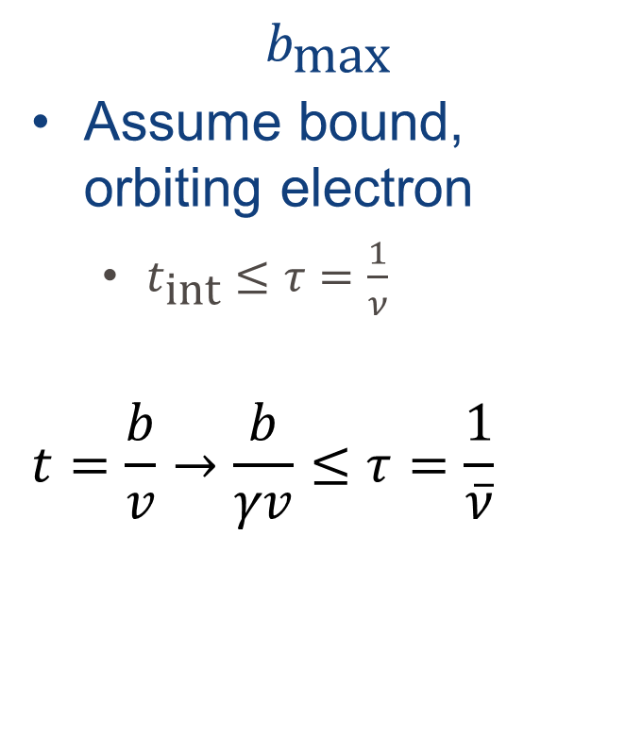
$b_{\text{max}}$ & $b_{\text{min}}$
$$b_{\text{min}}$$
Head on collision
e⁻ gets $∆E_{\text{max}}=2γ^{2}m_{e}v^{2}$
$$\begin{aligned}\frac{2z^{2}e^{4}}{m_{e}v^{2}b_{\text{min}}^{2}}&=&2γ^{2}m_{e}v^{2} \\ b_{\text{min}}&=&\frac{ze^{2}}{γm_{e}v^{2}}\end{aligned}$$
$$b_{\text{max}}$$
Assume bound, orbiting electron
$t_{\text{int}}≤τ=\frac{1}{ν}$
$$t=\frac{b}{v}→\frac{b}{γv}≤τ=\frac{1}{\overline{ν}}$$
Avg. orbital freq. over all orbits

Slide 28
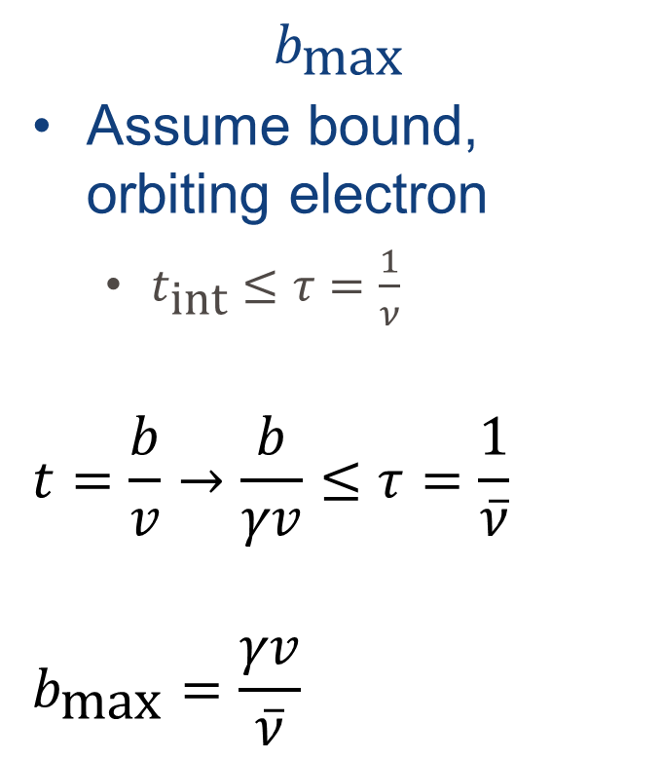
$b_{\text{max}}$ & $b_{\text{min}}$
$$b_{\text{min}}$$
Head on collision
e⁻ gets $∆E_{\text{max}}=2γ^{2}m_{e}v^{2}$
$$\begin{aligned}\frac{2z^{2}e^{4}}{m_{e}v^{2}b_{\text{min}}^{2}}&=&2γ^{2}m_{e}v^{2} \\ b_{\text{min}}&=&\frac{ze^{2}}{γm_{e}v^{2}}\end{aligned}$$
$$b_{\text{max}}$$
Assume bound, orbiting electron
$t_{\text{int}}≤τ=\frac{1}{ν}$
$$t=\frac{b}{v}→\frac{b}{γv}≤τ=\frac{1}{\overline{ν}}$$
$$b_{\text{max}}=\frac{γv}{\overline{ν}}$$
Notes:
Classically ΔE=(1/2)m(2v)²
w/Relativity, ΔE = (1/2)m(2vγ)²=2γ²mv²
t_{int} must be small because “otherwise the perturbation is adiabatic and no energy is transferred.”

Slide 29
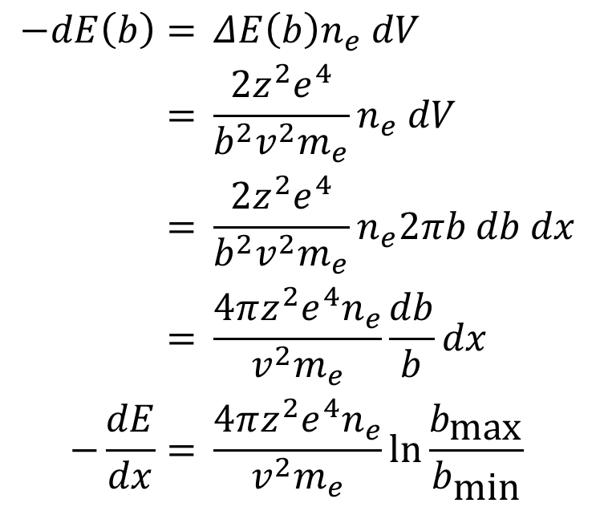
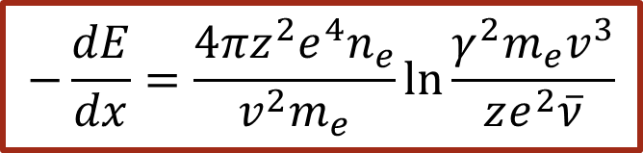
So the energy lost by the heavy ion is:
$$\begin{aligned}−dE\left(b\right)&=&&ΔE\left(b\right)n_{e} dV \\ &=&&\frac{2z^{2}e^{4}}{b^{2}v^{2}m_{e}}n_{e} dV \\ &=&&\frac{2z^{2}e^{4}}{b^{2}v^{2}m_{e}}n_{e}2πb db dx \\ &=&&\frac{4πz^{2}e^{4}n_{e}}{v^{2}m_{e}}\frac{db}{b}dx \\ −\frac{dE}{dx}&=&&\frac{4πz^{2}e^{4}n_{e}}{v^{2}m_{e}}\ln{\frac{b_{\text{max}}}{b_{\text{min}}}}\end{aligned}$$
$$−\frac{dE}{dx}=\frac{4πz^{2}e^{4}n_{e}}{v^{2}m_{e}}\ln{\frac{γ^{2}m_{e}v^{3}}{ze^{2}\overline{ν}}}$$
Notes:
This is the result of Bohr’s calculation and is perfectly fine for alpha’s and everything heavier.
For lighter beams, we need quantum mechanics

Slide 30

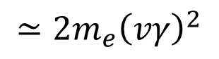
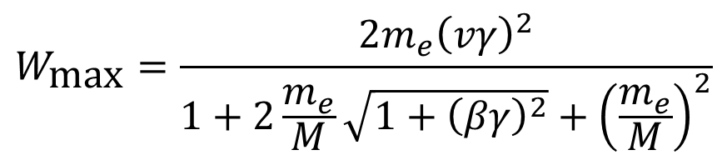
Charged particle energy loss – Due to e⁻
The Bethe-Block Equation for linear energy transfer
Energy loss/unit length
Max E transfer to e⁻
Shell Correction
Beam
Target
$$−\frac{dE}{dx}=2πN_{A}r_{e}^{2}m_{e}c^{2}ρ\left(\frac{Z}{A}\right)\frac{z^{2}}{β^{2}}\left[\ln\left(\frac{2m_{e}{γ^{2}c}^{2}β^{2}W_{\text{max}}}{I^{2}}\right)−2β^{2}−δ\left(β\right)−2\frac{C}{Z} \right]$$
$$W_{\text{max}}=\frac{2m_{e}{\left(vγ\right)}^{2}}{1+2\frac{m_{e}}{M}\sqrt{1+{\left(βγ\right)}^{2}}+{\left(\frac{m_{e}}{M}\right)}^{2}}$$
Density correction
Mean excitation energy (eV)
$$≃2m_{e}{\left(vγ\right)}^{2}$$
If $M≫m_{e}$
C. Leroy and P. Rancoita, Principles of radiation interaction in matter and detection, World Scientific (2004).
Notes:
Why electrons? Because most of matter is electrons.
Section 2.2 in Leo deals with each term in painstaking detail. Investigate at your peril leisure.

Slide 31
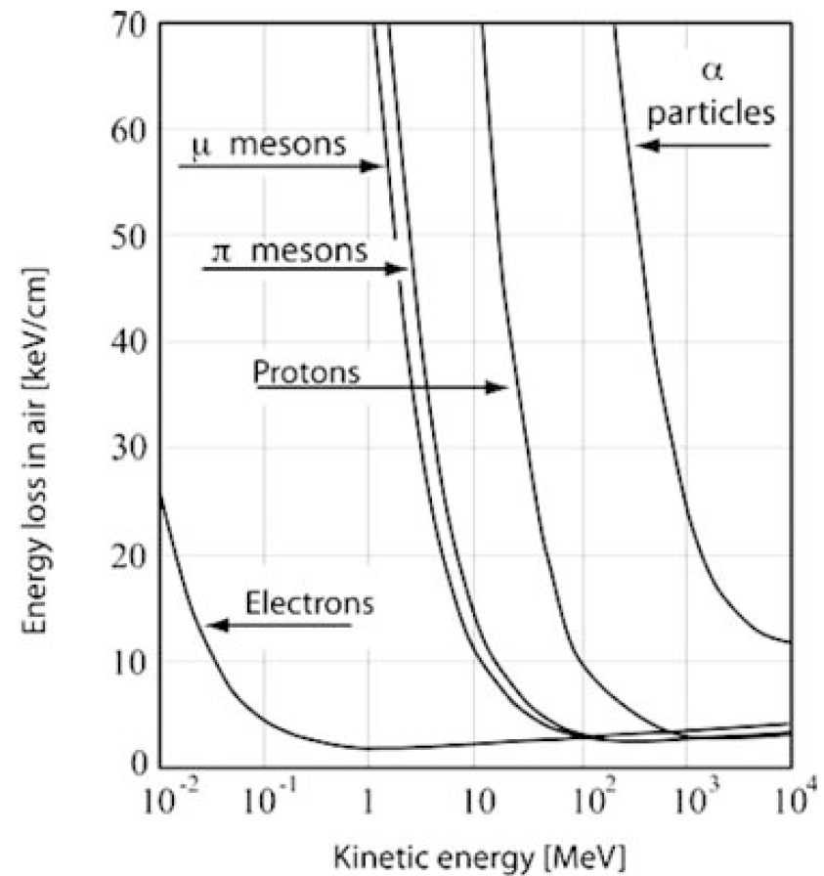
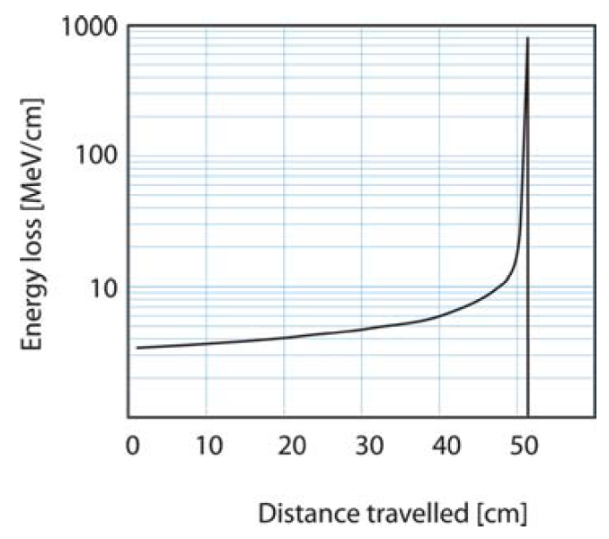
Charged particle energy loss – Due to e⁻
Bragg peak
Range: The distance a particle travels in medium before coming to rest
Electrons don’t have much mass
Notes:
Left – Energy loss in air as a function of particle KE
Calculated via Bethe Bloch formula
If density is in units of g/cm³ then E is in units of MeV
Right – 300 MeV proton in water
If E-loss decreases with increasing energy, it increases with decreasing energy

Slide 32
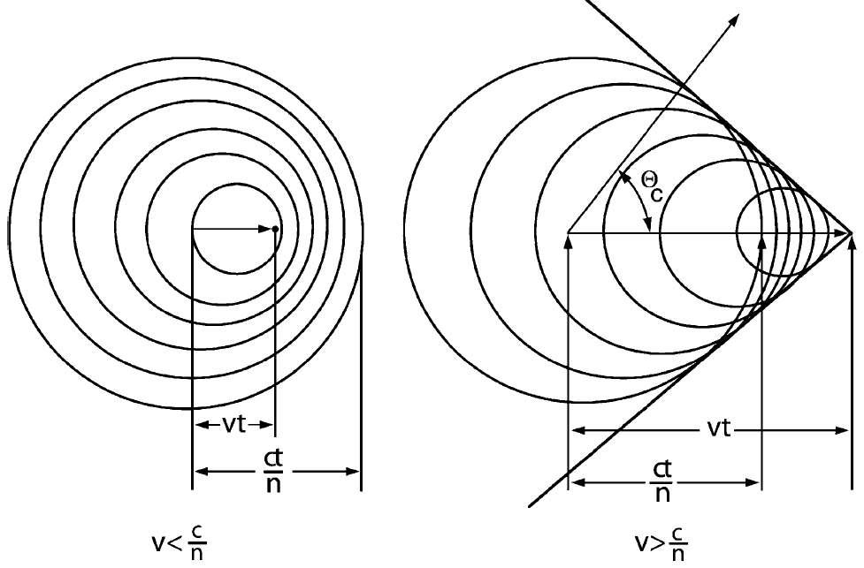

Cherenkov Radiation
Image taken from Tavernier (who took it from Jackson 13.4)
Material | n
Vacuum | 1.000000000000000000000000000000000
Air (@ STP) | 1.00028
Water (@ 20º C) | 1.333
Sodium Iodide | 1.736
Silicon | 3.443
Germanium | 4.065
Notes:
When a particle moves through a medium faster than the speed of light in that medium, it emits Cherenkov radiation.

Slide 33




Cherenkov Radiation
$$\cos\left(Θ_{C}\right)=\frac{\left(\frac{\text{ct}}{\text{n}}\right)}{\text{vt}}=\frac{\text{c}}{\text{nv}}$$
$$\frac{\text{ct}}{\text{n}}$$
$$E_{\text{min}}=mc^{2}\left(\sqrt{\frac{n^{2}}{n^{2}−1}}−1\right)$$
$$Θ_{C}$$
vt
Material | Neutron (MeV) | Electron (keV)
Air (@ STP) | 38,772 | 21
Water (@ 20º C) | 481 | 0.262
Sodium Iodide | 209 | 0.114
Silicon | 42 | 0.023
Germanium | 29 | 0.016
Notes:
It’s a shock wave. No different from the shock wave produced by a jet flying faster than the speed of sound.
The difference is that here, the emission is blue photons.
Tavernier gives a good derivation from Maxwell’s equations.
Jackson’s is more rigorous in Chapter 13

Slide 34







Bremsstrahlung
Emitted whenever a charged particle is accelerated
Collisions
B&E Field deflections
Total radiated power:
$$P=\frac{e^{2}γ^{6}}{6πε_{0}c}\left[{\dot{\vec{β}}}^{2}−{\left(\vec{β}×\dot{\vec{β}}\right)}^{2}\right]$$
Linear acceleration:
Since:
$$P=\frac{e^{2}γ^{6}}{6πε_{0}c}{\dot{\vec{β}}}^{2}$$
$$E=γmc^{2}$$
$$P\sim m^{−6}⟹$$
Perpendicular acceleration:
$$P=\frac{e^{2}γ^{4}}{6πε_{0}c}{\dot{\vec{β}}}^{2}$$
$$P\sim m^{−4}⟹$$
Notes:
Jackson’s treatment in chapter 14 is pretty good
For graph:
Dashed Line 1- Collisional Loss
Dashed Line 2 – Bremsstrahlung loss
Solid Line – Sum of dashed 1&2
Dotted Line – dE/dx for protons
The larger the mass, the less energy is radiated. This is why the ILC which uses (e⁻ & e⁺) needs to be an LC.

Slide 35
Charge Particle Overview (100 keV – 10 MeV)
 | Interaction Description
α’s | ~1000 MeV/cm/(mass density). Range ~10 µm in solid and cm in gas. Straight trajectory
β’s | ~2 MeV/cm/(charge density). Significant loss due to bremsstrahlung. Multiple scattering creates “random walk” trajectory. When β⁺ stop, they annihilate -> 2 x 511 keV γ
Protons | Range ~ 1 mm in solid and ~1 m in gas. Straight trajectory.
Nuclear fragments | Similar to α’s but more massive so more energy loss/distance. ~1 µm in solid. Straight line trajectory.

Slide 36


Slide 37

Photons Interacting with Matter
Photons primarily interact with matter in 3 ways:
Photoelectric Effect
Compton Scattering
Pair Production
Some others as well:
Photodisintegration: (γ,n), (γ,p), (γ,α)
Longer range in matter
Photons experience no energy loss (absorbed or not)
But beams can be attenuated: $I\left(x\right)=I_{0}^{}e^{−μx}$
Notes:
Won’t talk about photodisintegration in this context but important to astrophysics.
The attenuation is of a beam with many many photons. µ is the absorption coefficient and x is the material thickness.

Slide 38



The Photoelectric Effect
$$E_{\text{Kinetic}}=ℏω−E_{\text{Binding}}$$
The photon is totally absorbed.
If
$ℏω>E_{\text{Binding}}$ - Free electron
$ℏω<E_{\text{Binding}}$ - Excited, bound electron
Dominates for $E_{γ}≤100 \text{keV}$
$σ\sim \frac{Z^{n}}{E_{γ}^{3.5}}$
Notes:
n is between 3 and 4

Slide 39



Compton Scattering - Elastic collision between γ & e⁻
$$ℏω′=\frac{ℏω}{\left[1+\frac{ℏω}{mc^{2}}\left(1−\cos{θ}\right)\right]}$$
For homework, derive
$$\frac{dσ}{dΩ}=\frac{r_{e}^{2}}{2}\frac{1}{{\left[1+γ\left(1−\cos{θ}\right)\right]}^{2}}\left(1+\cos^{2}{θ}+\frac{γ^{2}{\left(1−\cos{θ}\right)}^{2}}{1+γ\left(1−\cos{θ}\right)}\right)$$
Notes:
This is the Klein-Nishina formula. It’s one of the first results achieved with quantum electrodynamics

Slide 40


Pair Production
When $E_{γ}>m_{e^{−}}+m_{e^{+}}=1022$ keV
$m_{μ^{−}}+m_{μ^{+}}=211,316$ keV
$m_{p}+m_{\overline{p}}=1,876,544$ keV
For the production to last, it must occur near the nucleus.
Otherwise, momentum would not be conserved
$$σ=\frac{7}{9}4αr_{0}^{2}Z\left(Z+1\right)\ln\left(\frac{183}{3\sqrt{Z}}\right)$$
Notes:
Far from the nucleus, a pair can’t be produced because a reference frame could be chosen where e- & e+ momenta sum to zero. Then the γ would have to have zero momentum -> Impossible
Near the nucleus, the Coulomb field allows the nucleus to take the momentum

Slide 41
Complete Photon Interaction Range
Notes:
At different energy ranges, different effects dominate:
1-100 keV => Photoelectric Effect. (Heavily Z dependent)
100 keV – 1 MeV => Compton scattering
> 1 MeV => Pair production

Slide 42
Neutrons → Strong Interaction only
Slow < 0.5 eV
Fast = 100 keV – 10 MeV
Elastic Scattering
Neutron capture followed by:
(n,p)
(n,d)
(n,α)
(n,t)
(n,αp)
(n,f)
Elastic Scattering
Neutron capture followed by….
Radiative neutron capture (n,γ)
Inelastic scattering
Nucleus is left in an excited state and emits a:
Photon
Charged particle
Fission
Notes:
Because there’s no Coulomb interaction, the neutron must be within 10⁻¹³ cm of the nucleus.

Slide 43

Neutrons → Strong Interaction only
High Energy > 100 MeV
High energy hadronic showers
See: LHC, the
Notes:
At high energies, the Coulomb barrier can be ignored and the neutron behaves similarly to the proton.

Slide 45


$I$ – Mean excitation potential
In theory:
$I=h\overline{ν}$
Hard to calculate…so fit to experiment
$\frac{I}{Z}=\left\{\begin{matrix}12+\frac{7}{Z} \text{e}\text{V} & Z<13 \\ 9.76+58.8Z^{−1.19} & Z≥13\end{matrix}\right.$
Doesn’t take into account atomic shell closures
Tables
Table 2.1 in Leo
Search “oscillator strength” in Atomic Data and Nuclear Data Tables (Elsevier)
Notes:
“I” is, theoretically, a logarithmic average of orbital frequencies weighted by the oscillator strengths of atomic levels.
“Oscillator strength” – dimensionless quantity that expresses the probability of absorption of emission of energy in level transitions

Slide 46

Charged particle energy loss – Due to e⁻

Slide 47



Radiation Length ($X_{0}$)
$$\frac{1}{X_{0}}≈4αr_{0}^{2}\frac{ρN_{A}}{A_{r}}Z_{\text{nucl}}\left(1+Z_{\text{nucl}}\right)\ln\left(\frac{183}{\sqrt[3]{Z_{\text{nucl}}}}\right)$$

